Slide 1

COMPUTER NETWORKS
Department of Computer Science, Presidency University
Notes:
Department of Computer Science, Presidency University

Slide 2
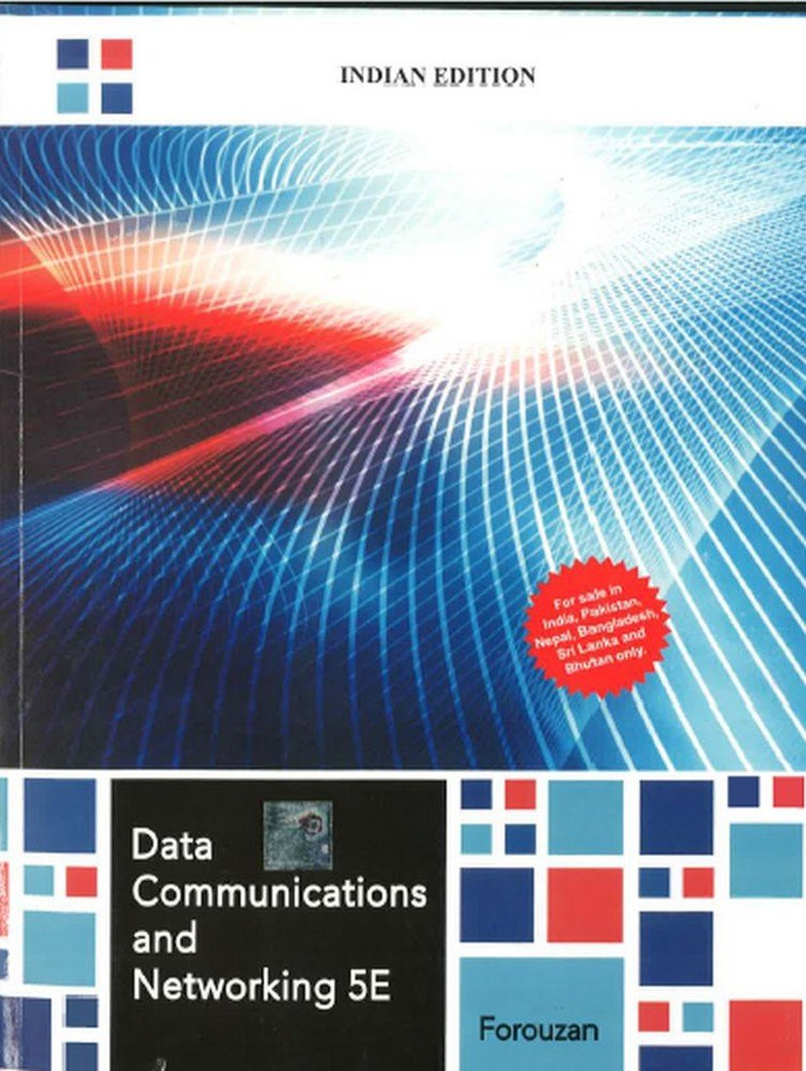
Text Book
Department of Computer Science, Presidency University
Notes:
Department of Computer Science, Presidency University

Slide 3

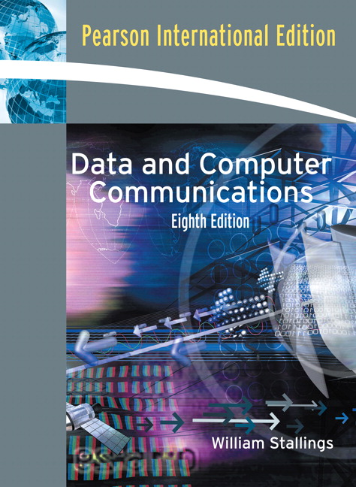
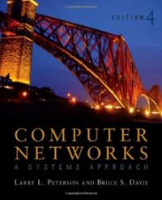
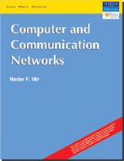
Reference Books
Department of Computer Science, Presidency University
Notes:
Department of Computer Science, Presidency University

Slide 4
Chapter 1
Introduction
Department of Computer Science, Presidency University
Notes:
Department of Computer Science, Presidency University

Slide 5
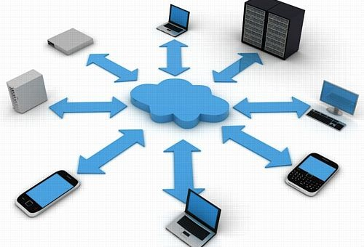


Outline
Data Communication
Networks
Network Types
Internet History
Standards and Administrations
Notes:
Department of Computer Science, Presidency University

Slide 6
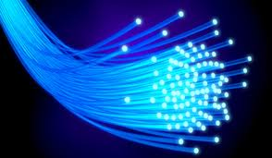
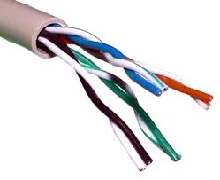
Data Communications
Data communications and networking are changing today's world. Why wait for a week for some report from US to arrive by post where you can receive instantaneously through computer networks?
Here we have to know how networks operate and what type of technologies are available.
Data communications are the exchange of data between two devices via some form of transmission medium such as a wire cable.
Department of Computer Science, Presidency University
Notes:
Department of Computer Science, Presidency University

Slide 7


Characteristics
The four fundamental characteristics of data communications are:-
Delivery: The system must deliver data to the correct destination. Data must be received by the intended device or user and only by that device or user.
Accuracy: The system must deliver the data accurately. Data that have been altered in transmission and left uncorrected are unusable.
Department of Computer Science, Presidency University
Notes:
Department of Computer Science, Presidency University

Slide 8

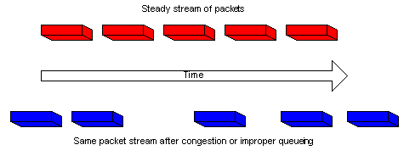
Characteristics
Timeliness: The system must deliver data in a timely manner. Data delivered late are useless. In the case of video and audio, timely delivery means delivering data as they are produced, in the same order that they are produced, and without significant delay.
Jitter: Jitter refers to the variation in the packet arrival time. It is the uneven delay in the delivery of audio or video packets. For example, let us assume that video packets are sent every 30ms. If some of the packets arrive with 30-ms delay and others with 40-ms delay, an uneven quality in the video is the result.
Department of Computer Science, Presidency University
Notes:
Department of Computer Science, Presidency University

Slide 9
Q.) What is data communication? What are its four important characteristics?
Q.) What is data communications? What are its characteristics? Explain
Dec 2010, 2011, 2013, 2014, 2015, 2016 June 2012, 2013, 2015 → (06 Marks)
Department of Computer Science, Presidency University
Notes:
Department of Computer Science, Presidency University

Slide 10

Components
Figure: Five components of data communication
Department of Computer Science, Presidency University
Notes:
Department of Computer Science, Presidency University

Slide 11
Components
The five components of data communications are:
Message: The message is the information (data) to be communicated. Popular forms of information include text, numbers, pictures, audio, and video.
Sender: The sender is the device that sends the data message. It can be a computer, workstation, telephone handset, mobile, and so on.
Receiver: The receiver is the device that receives the message. It can be a computer, workstation, telephone handset, television, and so on.
Transmission medium: The transmission medium is the physical path by which a message travels from sender to receiver. Some examples of transmission media include twisted-pair wire, coaxial cable, fibre-optic cable, and radio waves.
Department of Computer Science, Presidency University
Notes:
Department of Computer Science, Presidency University

Slide 12
Cntd..
Protocol: A protocol is a set of rules that govern data communications. It represents an agreement between the communicating devices. Without a protocol, two devices may be connected but not communicating.
Q.) What is data communication? What are its characteristics and components? Explain
(08 Marks)
Department of Computer Science, Presidency University
Notes:
Department of Computer Science, Presidency University

Slide 13
Data Representation
Information today comes in different forms such as :
Text
Numbers
Images
Audio
Video
Department of Computer Science, Presidency University
Notes:
Department of Computer Science, Presidency University

Slide 14

Data Flow
Figure: Data flow (simplex, half-duplex, and full-duplex)
Department of Computer Science, Presidency University
Notes:
Department of Computer Science, Presidency University

Slide 15
Cntd..
Communication between two devices can be simplex, half-duplex, or full-duplex as shown in figure above.
Simplex
In simplex mode, the communication is unidirectional, as on a one-way street. Only one of the two devices on a link can transmit; the other can only receive.
Keyboards and traditional monitors are examples of simplex devices. The keyboard can only introduce input; the monitor can only accept output. The simplex mode can use the entire capacity of the channel to send data in one direction.
Half-Duplex
In half-duplex mode, each station can both transmit and receive, but not at the same time. When one device is sending, the other can only receive, and vice versa.
Department of Computer Science, Presidency University
Notes:
-
Department of Computer Science, Presidency University

Slide 16
Cntd..
In a half-duplex transmission, the entire capacity of a channel is taken over by whichever of the two devices is transmitting at the time.
Example: Walkie-Talkie
Full-Duplex
In full-duplex mode (also called duplex), both stations can transmit and receive simultaneously.
In full-duplex mode, signals going in one direction share the capacity of the link with signals going in the other direction.
Example: Telephone
Department of Computer Science, Presidency University
Notes:
Department of Computer Science, Presidency University

Slide 17
Networks
“A network is a set of devices (often referred to as nodes) connected by communication links”
A node can be a computer, printer, or any other device capable of sending and receiving data generated by other nodes on the network.
When we connect two computers at home using a plug-and-play router, we have created a network, although very small.
Topics discussed in this section:
Network Criteria
Physical Structures
Physical Topology
Department of Computer Science, Presidency University
Notes:
Department of Computer Science, Presidency University

Slide 18
Cntd..
Network Criteria : A network must be able to meet a certain number of criteria. The most important of these are:
Performance
Reliability
Security
Department of Computer Science, Presidency University
Notes:
Department of Computer Science, Presidency University

Slide 19
Performance
Performance can be measured in many ways, including transit time and response time.
Transit time is the amount of time required for a message to travel from one device to another.
Response time is the elapsed time between an inquiry and a response.
The performance of a network depends on a number of factors, including the number of users, the type of transmission medium, the capabilities of the connected hardware, and the efficiency of the software.
Performance is often evaluated by two networking metrics: throughput and delay.
We often need more throughput and less delay.
However, these two criteria are often contradictory. If we try to send more data to the network, we may increase throughput but we increase the delay because of traffic congestion in the network.
Department of Computer Science, Presidency University
Notes:
Department of Computer Science, Presidency University

Slide 20
Network Criteria(cntd…)
Reliability
Network reliability is measured by the frequency of failure, that is the time it takes a link to recover from a failure.
Security
Network security deals with protecting data from unauthorized access.
Department of Computer Science, Presidency University
Notes:
Department of Computer Science, Presidency University

Slide 21

Physical Structures
Physical Structures
Figure: Types of connections: point-to-point and multipoint
Department of Computer Science, Presidency University
Notes:
Department of Computer Science, Presidency University

Slide 22
Cntd..
Type of Connection
There are two possible types of connections: Point-to-Point and Multipoint.
Point-to-Point
A point-to-point connection provides a dedicated link between two devices.
The entire capacity of the link is reserved for transmission between those two devices.
Multipoint
Multipoint connection is one in which more than two specific devices share a single link.
In a multipoint environment, the capacity of the channel is shared.
It is a timeshared connection.
7.2.6.1
Department of Computer Science, Presidency University
Notes:
Department of Computer Science, Presidency University

Slide 23

Physical Topology
The term physical topology refers to the way in which a network is laid out physically.
Two or more devices connect to a link; two or more links form a topology.
Definition
“The topology of a network is the geometric representation of the relationship of all the links and linking devices (usually called nodes) to one another.”
Figure : Categories of topology
Department of Computer Science, Presidency University
Notes:
Department of Computer Science, Presidency University

Slide 24

Mesh Topology
Figure : A fully connected mesh topology (five devices)
In a mesh topology, every device has a dedicated point-to-point link to every other device. The term dedicated means that the link carries traffic only between the two devices it connects.
To find the number of physical links in a fully connected mesh network with n nodes, we first consider that each node must be connected to every other node. Node 1 must be connected to
n - 1 nodes, node 2 must be connected to n – 1 nodes, and finally node n must be connected to
n - 1 nodes. We need n (n - 1) physical links.
Department of Computer Science, Presidency University
Notes:
Department of Computer Science, Presidency University

Slide 25
Cntd..
However, if each physical link allows communication in both directions (duplex mode), we can divide the number of links by 2. In other words, we can say that in a mesh topology, we need n (n -1) /2 duplex-mode links.
Advantages
The use of dedicated links guarantees that each connection can carry its own data load, thus eliminating the traffic problems that can occur when links must be shared by multiple devices.
A mesh topology is robust. If one link becomes unusable, it does not incapacitate the entire system.
There is the advantage of privacy or security. When every message travels along a dedicated line, only the intended recipient sees it. Physical boundaries prevent other users from gaining access to messages.
Fault identification and fault isolation easy.
Department of Computer Science, Presidency University
Notes:
Department of Computer Science, Presidency University

Slide 26
Cntd..
Dis-Advantages
The main disadvantages of a mesh are related to the amount of cabling and the number of I/O ports required.
Every device must be connected to every other device, installation and reconnection are difficult.
The sheer bulk of the wiring can be greater than the available space (in walls, ceilings, or floors) can accommodate.
Finally, the hardware required to connect each link (I/O ports and cable) can be prohibitively expensive.
Department of Computer Science, Presidency University
Notes:
Department of Computer Science, Presidency University

Slide 27

Star Topology
Figure : A star topology connecting four stations
In a star topology, each device has a dedicated point-to-point link only to a central controller, usually called a hub. The devices are not directly linked to one another.
The controller acts as an exchange: If one device wants to send data to another, it sends the data to the controller, which then relays the data to the other connected devices.
Unlike a mesh topology, a star topology does not allow direct traffic between devices.
Department of Computer Science, Presidency University
Notes:
Department of Computer Science, Presidency University

Slide 28
Cntd..
Advantages
A star topology is less expensive than a mesh topology.
Far less cabling needs to be housed, and additions, moves, and deletions involve only one connection: between that device and the hub.
If one link fails, only that link is affected. All other links remain active.
Fault identification and fault isolation easy.
Dis-Advantages
One big disadvantage of a star topology is the dependency of the whole topology on one single point, the hub. If the hub goes down, the whole system is dead.
Department of Computer Science, Presidency University
Notes:
Department of Computer Science, Presidency University

Slide 29

Bus Topology
Figure : A bus topology connecting three stations
The preceding topologies all describe point-to-point connections. A bus topology, on the other hand, is multipoint.
One long cable acts as a backbone to link all the devices in a network.
Nodes are connected to the bus cable by drop lines and taps.
A drop line is a connection running between the device and the main cable. A tap is a connector that either splices into the main cable or punctures the sheathing of a cable to create a contact with the metallic core.
Department of Computer Science, Presidency University
Notes:
Department of Computer Science, Presidency University

Slide 30
Cntd..
Advantages
Ease of installation. Backbone cable can be laid along the most efficient path, and then connected to the nodes by drop lines of various lengths.
A bus uses less cabling than mesh or star topologies.
Dis-Advantages
Difficult reconnection and fault isolation.
Signal reflection at the taps can cause degradation in quality.
Adding new devices may therefore require modification or replacement of the backbone.
A fault or break in the bus cable stops all transmission.
Department of Computer Science, Presidency University
Notes:
Department of Computer Science, Presidency University

Slide 31

Ring Topology
Figure : A ring topology connecting six stations
In a ring topology, each device has a dedicated point-to-point connection with only the two devices on either side of it.
A signal is passed along the ring in one direction, from device to device, until it reaches its destination.
Each device in the ring incorporates a repeater. When a device receives a signal intended for another device, its repeater regenerates the bits and passes them along.
Department of Computer Science, Presidency University
Notes:
Department of Computer Science, Presidency University

Slide 32
Cntd..
Advantages
A ring is relatively easy to install and reconfigure. Each device is linked to only its immediate neighbors.
To add or delete a device requires changing only two connections.
Generally in a ring, a signal is circulating at all times. If one device does not receive a signal within a specified period, it can issue an alarm. The alarm alerts the network operator to the problem and its location.
Dis-Advantages
Unidirectional traffic can be a disadvantage. In a simple ring, a break in the ring (such as a disabled station) can disable the entire network. This weakness can be solved by using a dual ring.
Department of Computer Science, Presidency University
Notes:
Department of Computer Science, Presidency University

Slide 33

Hybrid Topology
Figure : A hybrid topology: a star backbone with three bus networks
A network can be hybrid. For example, we can have a main star topology with each branch connecting several stations in a bus.
Department of Computer Science, Presidency University
Notes:
Department of Computer Science, Presidency University

Slide 34
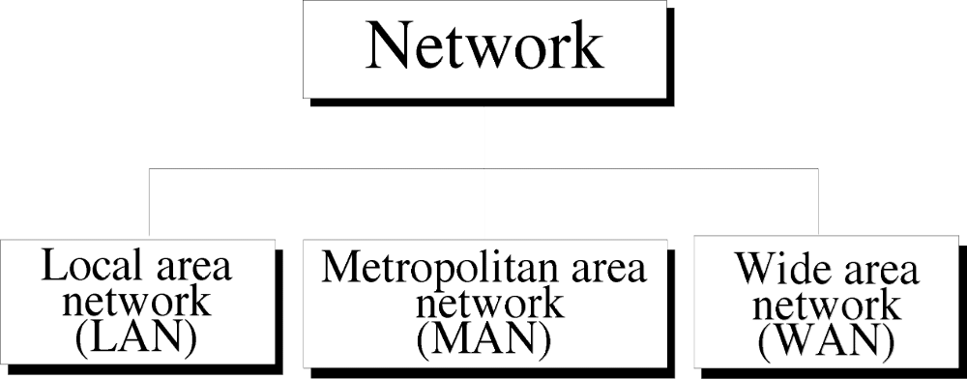
Network Types
Today when we speak of networks, we are generally referring to three primary categories: LAN , MAN and WAN.
The Category into which the network falls is determined by its size.
Department of Computer Science, Presidency University
Notes:
Department of Computer Science, Presidency University

Slide 35

LAN
Figure : An isolated LAN connecting 12 computers to a hub in a closet
A local area network (LAN) is usually privately owned and links the devices in a single office, building, or campus.
Depending on the needs of an organization and the type of technology used, a LAN can be as simple as two PCs and a printer in someone's home office.
LANs are designed to allow resources to be shared between personal computers or workstations.
Each host in a LAN has an identifier, an address, that uniquely defines the host in the LAN. A packet sent by a host to another host carries both the source host’s and the destination host’s addresses.
Department of Computer Science, Presidency University
Notes:
Department of Computer Science, Presidency University

Slide 36
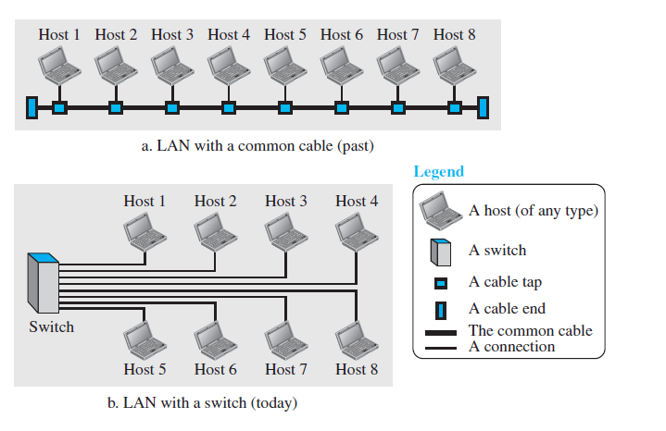
LAN
In the past, all hosts in a network were connected through a common cable, which meant that a packet sent from one host to another was received by all hosts. The intended recipient kept the packet; the others dropped the packet.
Today, most LANs use a smart connecting switch, which is able to recognize the destination address of the packet and guide the packet to its destination without sending it to all other hosts.
Department of Computer Science, Presidency University
Notes:
Department of Computer Science, Presidency University

Slide 37
WAN
A wide area network (WAN) is also an interconnection of devices capable of communication.
However, there are some differences between a LAN and a WAN.
LAN | WAN
A LAN is normally limited in size, spanning an office, a building, or a campus; | A WAN has a wider geographical span, spanning a town, a state, a country, or even the world.
A LAN interconnects hosts; | A WAN interconnects connecting devices such as switches, routers, or modems.
A LAN is normally privately owned by the organization that uses it; | A WAN is normally created and run by communication companies and leased by an organization that uses it.
Department of Computer Science, Presidency University
Notes:
Department of Computer Science, Presidency University

Slide 38
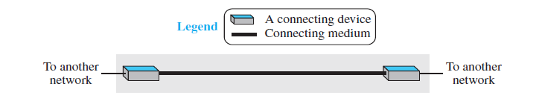
WAN
We see two distinct examples of WANs today: point-to-point WANs and switched WANs.
Point-to-Point WAN
A point-to-point WAN is a network that connects two communicating devices through a transmission media (cable or air).
Department of Computer Science, Presidency University
Notes:
Department of Computer Science, Presidency University

Slide 39
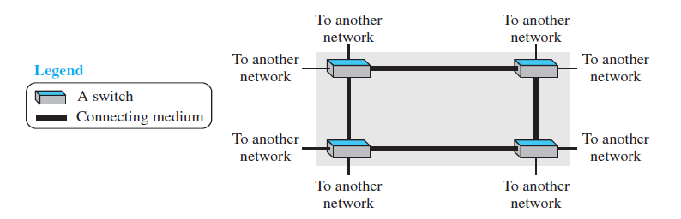
WAN
Switched WAN
A switched WAN is a network with more than two ends. A switched WAN, as we will see shortly, is used in the backbone of global communication today.
We can say that a switched WAN is a combination of several point-to-point WANs that are connected by switches.
Department of Computer Science, Presidency University
Notes:
Department of Computer Science, Presidency University

Slide 40
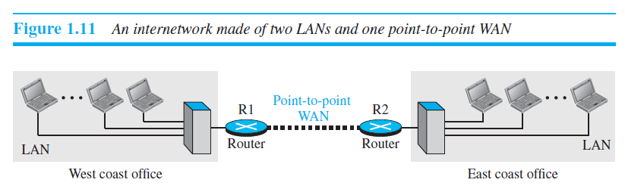
Internetwork
Today, it is very rare to see a LAN or a WAN in isolation; they are connected to one another. When two or more networks are connected, they make an internetwork, or internet.
Department of Computer Science, Presidency University
Notes:
Department of Computer Science, Presidency University

Slide 41
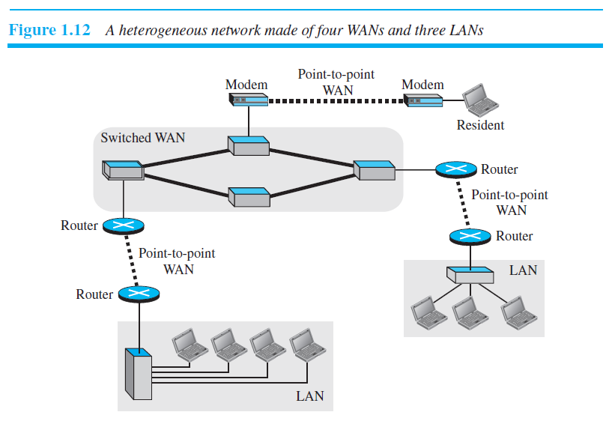
WAN
This shows another internet with several LANs and WANs connected. One of the WANs is a switched WAN with four switches.
Department of Computer Science, Presidency University
Notes:
Department of Computer Science, Presidency University

Slide 42
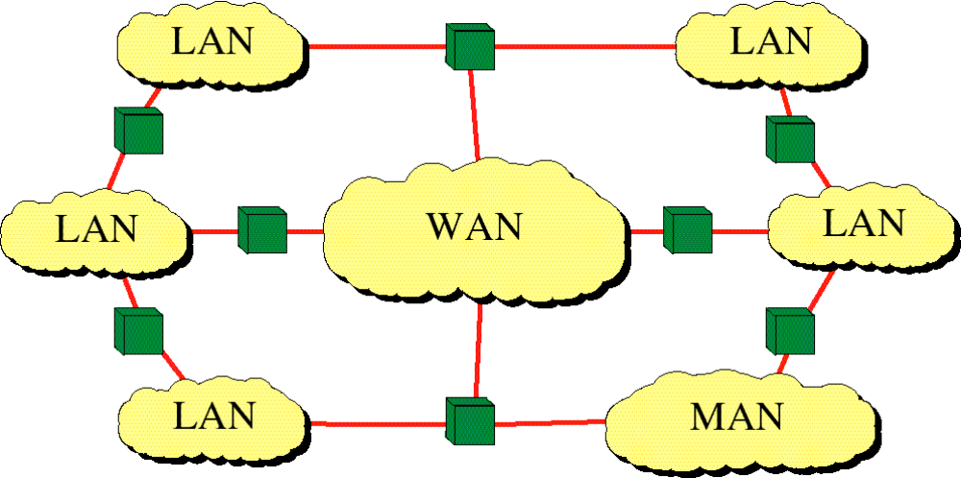
Internetwork
(Internet)
Department of Computer Science, Presidency University
Notes:
Department of Computer Science, Presidency University

Slide 43
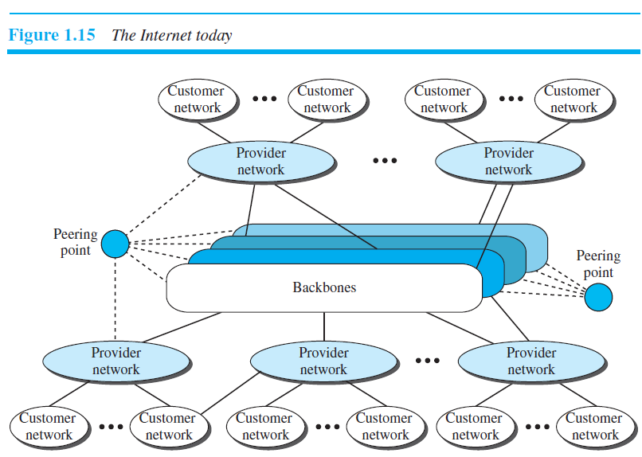
The Internet
An internet is two or more networks that can communicate with each other and is composed of thousands of interconnected networks.
Department of Computer Science, Presidency University
Notes:
Department of Computer Science, Presidency University

Slide 44
Cntd…
The figure above shows the Internet as several backbones, provider networks, and customer networks.
At the top level, the backbones are large networks owned by some communication companies such as Sprint, Verizon (MCI), AT&T, and NTT.
The backbone networks are connected through some complex switching systems, called peering points.
At the second level, there are smaller networks, called provider networks, that use the services of the backbones for a fee.
The provider networks are connected to backbones and sometimes to other provider networks.
The customer networks are networks at the edge of the Internet that actually use the services provided by the Internet. They pay fees to provider networks for receiving services.
Department of Computer Science, Presidency University
Notes:
Department of Computer Science, Presidency University

Slide 45
Cntd…
Backbones and provider networks are also called Internet Service Providers (ISPs).
The backbones are often referred to as international ISPs.
The provider networks are often referred to as national or regional ISPs.
Department of Computer Science, Presidency University
Notes:
Department of Computer Science, Presidency University

Slide 46
Accessing the Internet
The Internet today is an internetwork that allows any user to become part of it.
Using Telephone Networks
Today most residences and small businesses have telephone service, which means they are connected to a telephone network.
Dial-up service: The first solution is to add to the telephone line a modem that converts data to voice. The software installed on the computer dials the ISP and imitates making a telephone connection. Unfortunately, the dial-up service is very slow, and when the line is used for Internet connection, it cannot be used for telephone (voice) connection. It is only useful for small residences.
DSL Service: Since the advent of the Internet, some telephone companies have upgraded their telephone lines to provide higher speed Internet services to residences or small businesses. The DSL service also allows the line to be used simultaneously for voice and data communication.
Department of Computer Science, Presidency University
Notes:
Department of Computer Science, Presidency University

Slide 47
Cntd…
Using Cable Networks: More and more residents over the last two decades have begun using cable TV services instead of antennas to receive TV broadcasting. The cable companies have been upgrading their cable networks and connecting to the Internet.
Using Wireless Networks: Wireless connectivity has recently become increasingly popular. A household or a small business can use a combination of wireless and wired connections to access the Internet.
Direct Connection to the Internet: A large organization or a large corporation can itself become a local ISP and be connected to the Internet.
Department of Computer Science, Presidency University
Notes:
Department of Computer Science, Presidency University

Slide 48
INTERNET HISTORY
Now that we have given an overview of the Internet, let us give a brief history of the Internet.
Early History
There were some communication networks, such as telegraph and telephone networks, before 1960. These networks were suitable for constant-rate communication at that time, which means that after a connection was made between two users, the encoded message (telegraphy) or voice (telephony) could be exchanged.
Birth of Packet-Switched Networks
The theory of packet switching for bursty traffic was first presented by Leonard Kleinrock in 1961 at MIT. At the same time, two other researchers, Paul Baran at Rand Institute and Donald Davies at National Physical Laboratory in England, published some papers about packet-switched networks.
Department of Computer Science, Presidency University
Notes:
Department of Computer Science, Presidency University

Slide 49
Cntd…
ARPANET
In the mid-1960s, mainframe computers in research organizations were stand-alone devices. Computers from different manufacturers were unable to communicate with one another. The Advanced Research Projects Agency (ARPA) in the Department of Defense (DOD) was interested in finding a way to connect computers.
In 1967, ARPA presented its ideas for the Advanced Research Projects Agency Network (ARPANET), a small network of connected computers. The idea was that each host computer would be attached to a specialized computer, called an interface message processor (IMP). The IMPs, in turn, would be connected to each other. Each IMP had to be able to communicate with other IMPs as well as with its own attached host.
By 1969, ARPANET was a reality. Software called the Network Control Protocol (NCP) provided communication between the hosts.
Department of Computer Science, Presidency University
Notes:
Department of Computer Science, Presidency University

Slide 50
Birth of the Internet
In 1972, Vint Cerf and Bob Kahn, both of whom were part of the core ARPANET group, collaborated on what they called the Internetting Project. They wanted to link dissimilar networks so that a host on one network could communicate with a host on another.
TCP/IP
Cerf and Kahn’s landmark 1973 paper outlined the protocols to achieve end-to-end delivery of data. This was a new version of NCP. This paper on transmission control protocol (TCP) included concepts such as encapsulation, the datagram, and the functions of a gateway.
Shortly thereafter, authorities made a decision to split TCP into two protocols: Transmission Control Protocol (TCP) and Internet Protocol (IP). IP would handle datagram routing while TCP would be responsible for higher level functions such as segmentation, reassembly, and error detection. The new combination became known as TCP/IP.
Department of Computer Science, Presidency University
Notes:
Department of Computer Science, Presidency University

Slide 51
Cntd…
MILNET
In 1983, ARPANET split into two networks: Military Network (MILNET) for military users and ARPANET for nonmilitary users.
CSNET
Another milestone in Internet history was the creation of CSNET in 1981. Computer Science Network (CSNET) was a network sponsored by the National Science Foundation (NSF). The network was conceived by universities that were ineligible to join ARPANET due to an absence of ties to the Department of Defense. CSNET was a less expensive network; there were no redundant links and the transmission rate was slower.
NSFNET
With the success of CSNET, the NSF in 1986 sponsored the National Science Foundation Network (NSFNET), a backbone that connected five supercomputer centers located throughout the United States.
Department of Computer Science, Presidency University
Notes:
Department of Computer Science, Presidency University

Slide 52
Cntd…
ANSNET
In 1991, the U.S. government decided that NSFNET was not capable of supporting the rapidly increasing Internet traffic. Three companies, IBM, Merit, and Verizon, filled the void by forming a nonprofit organization called Advanced Network & Services (ANS) to build a new, high-speed Internet backbone called Advanced Network Services Network (ANSNET).
Department of Computer Science, Presidency University
Notes:
Department of Computer Science, Presidency University

Slide 53
Internet Today
Today, we witness a rapid growth both in the infrastructure and new applications. What has made the Internet so popular is the invention of new applications.
World Wide Web
The 1990s saw the explosion of Internet applications due to the emergence of the World Wide Web (WWW).
Multimedia
Recent developments in the multimedia applications such as voice over IP (telephony), video over IP (Skype), view sharing (YouTube), and television over IP (PPLive) has increased the number of users and the amount of time each user spends on the network.
Peer-to-Peer Applications
Peer-to-peer networking is also a new area of communication with a lot of potential.
Department of Computer Science, Presidency University
Notes:
Department of Computer Science, Presidency University

Slide 54
STANDARDS AND ADMINISTRATION
Internet Standards
An Internet standard is a thoroughly tested specification that is useful to and adhered to by those who work with the Internet.
It is a formalized rules & regulation that must be followed.
A specification begins as an Internet draft. An Internet draft is a working document (a work in progress) with no official status and a six-month lifetime.
Upon recommendation from the Internet authorities, a draft may be published as a Request for Comment (RFC).
Each RFC is edited, assigned a number, and made available to all interested parties.
RFCs go through maturity levels and are categorized according to their requirement level.
Department of Computer Science, Presidency University
Notes:
Department of Computer Science, Presidency University

Slide 55
Cntd….
Maturity Levels
An RFC, during its lifetime, falls into one of five maturity levels:
Proposed Standard: A proposed standard is a specification that is stable, well understood, and of sufficient interest to the Internet community
Draft Standard: A proposed standard is elevated to draft standard status after at least two successful independent and interoperable implementations.
Internet Standard: A draft standard reaches Internet standard status after demonstrations of successful implementation.
Experimental: An RFC classified as experimental describes work related to an experimental situation that does not affect the operation of the Internet.
Informational: An RFC classified as informational contains general, historical, or tutorial information related to the Internet.
Department of Computer Science, Presidency University
Notes:
Department of Computer Science, Presidency University

Slide 56
Cntd….
Requirement Levels
RFCs are classified into five requirement levels:
Required: An RFC is labeled required if it must be implemented by all Internet systems to achieve minimum conformance. For example, IP and ICMP.
Recommended: An RFC labeled recommended is not required for minimum conformance; it is recommended because of its usefulness. For example, FTP and TELNET
Elective: An RFC labeled elective is not required and not recommended. However, a system can use it for its own benefit.
Limited Use: An RFC labeled limited use should be used only in limited situations. Most of the experimental RFCs fall under this category.
Not Recommended: An RFC labeled not recommended is inappropriate for general use.
Department of Computer Science, Presidency University
Notes:
Department of Computer Science, Presidency University

Slide 57
Internet Administration
Following are the few administrations that coordinate internet issues and have guided the growth and development of internet:
ISOC:
The Internet Society (ISOC) is an international organization formed in 1992 to provide support for the Internet standards process.
ISOC accomplishes this through maintaining and supporting other Internet administrative bodies such as IAB, IETF, IRTF, and IANA.
ISOC also promotes research and other scholarly activities relating to the Internet.
IAB:
The Internet Architecture Board (IAB) is the technical advisor to the ISOC.
The main purposes of the IAB are to oversee the continuing development of the TCP/IP Protocol Suite.
Department of Computer Science, Presidency University
Notes:
Department of Computer Science, Presidency University

Slide 58
Internet Administration
IETF:
The Internet Engineering Task Force (IETF) is a forum of working groups.
IETF is responsible for identifying operational problems and proposing solutions to these problems.
IETF also develops and reviews specifications intended as Internet standards.
IRTF:
The Internet Research Task Force (IRTF) is a forum of working groups.
IRTF focuses on long-term research topics related to Internet protocols, applications, architecture, and technology.
Department of Computer Science, Presidency University
Notes:
Department of Computer Science, Presidency University

Slide 59
Overall Summary of Chapter-1
Data communication is the transfer of data from one device to another via some form of transmission medium.
A data communications system must transmit data to the correct destination in an accurate and timely manner.
The five components that make up a data communications system are the message, sender, receiver, medium, and protocol.
Text, numbers, images, audio, and video are different forms of information.
Data flow between two devices can occur in one of three ways: simplex, half-duplex, or full-duplex.
A network is a set of communication devices connected by media links.
Department of Computer Science, Presidency University
Notes:
Department of Computer Science, Presidency University

Slide 60
A network can be categorized as a local area network (LAN), a metropolitan-area network (MAN), or a wide area network (WAN).
A LAN is a data communication system within a building, plant, or campus, or between nearby buildings.
A MAN is a data communication system covering an area the size of a town or city.
A WAN is a data communication system spanning states, countries, or the whole world.
An internet is a network of networks.
The Internet is a collection of many separate networks.
There are local, regional, national, and international Internet service providers (ISPs).
Department of Computer Science, Presidency University
Notes:
Department of Computer Science, Presidency University

Slide 61
In a point-to-point connection, two and only two devices are connected by a dedicated link. In a multipoint connection, three or more devices share a link.
Topology refers to the physical or logical arrangement of a network. Devices may be arranged in a mesh, star, bus, or ring topology.
A protocol is a set of rules that governs data communication; the key elements of a protocol are syntax, semantics, and timing.
Standards are necessary to ensure that products from different manufacturers can work together as expected.
Department of Computer Science, Presidency University
Notes:
Department of Computer Science, Presidency University

Slide 62
*END of Chapter 1*
Department of Computer Science, Presidency University
Notes:
Department of Computer Science, Presidency University

